Slide 1
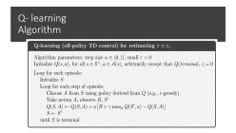
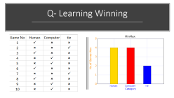
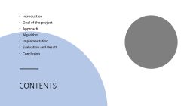
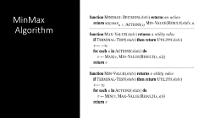
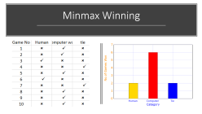
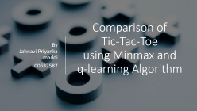
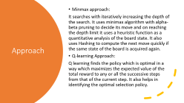
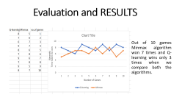
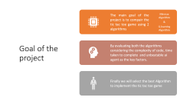
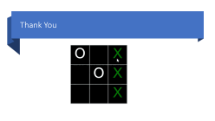
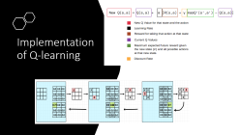
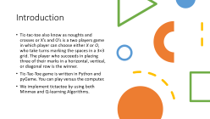
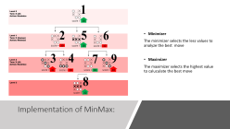
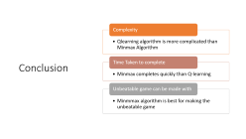
Final Project

Slide 2

Comparison of Tic-Tac-Toe using Minmax and q-learning Algorithm
By Jahnavi Priyanka maddi
00687587

Slide 3
CONTENTS
Introduction
Goal of the project
Approach
Algorithm
Implementation
Evaluation and Result
Conclusion

Slide 4
Introduction
Tic-tac-toe also know as noughts and crosses or X’s and O’s is a two players game in which player can choose either X or O, who take turns marking the spaces in a 3×3 grid. The player who succeeds in placing three of their marks in a horizontal, vertical, or diagonal row is the winner.
Tic-Tac-Toe game is written in Python and pyGame. You can play versus the computer.
We implement tictactoe by using both Minmax and Q-learning Algorithms.

Slide 5
Goal of the project
The main goal of the project is to compair the tic tac toe game using 2 algorithms
Minmax Algorithm
Q-learning Algorithm
By evaluating both the algorithms considering the complexity of code, time taken to complete and unbeatable ai agent as the key factors.
Finally we will select the best Algorithm to implement the tic tac toe game
&

Slide 6
Approach
Minmax approach:
It searches with iteratively increasing the depth of the search. It uses minimax algorithm with alpha-beta pruning to decide its move and on reaching the depth limit it uses a heuristic function as a quantitative analysis of the board state. It also uses Hashing to compute the next move quickly if the same state of the board is acquired again.
Q-learning Approach:
Q learning finds the policy which is optimal in a way which maximizes the expected value of the total reward to any or all the successive steps from that of the current step. It also helps in identifying the optimal selection policy.

Slide 7
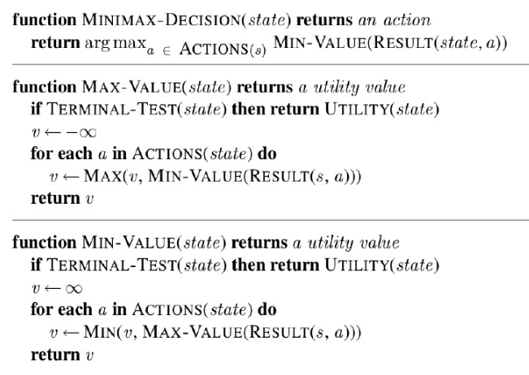
MinMax Algorithm

Slide 8
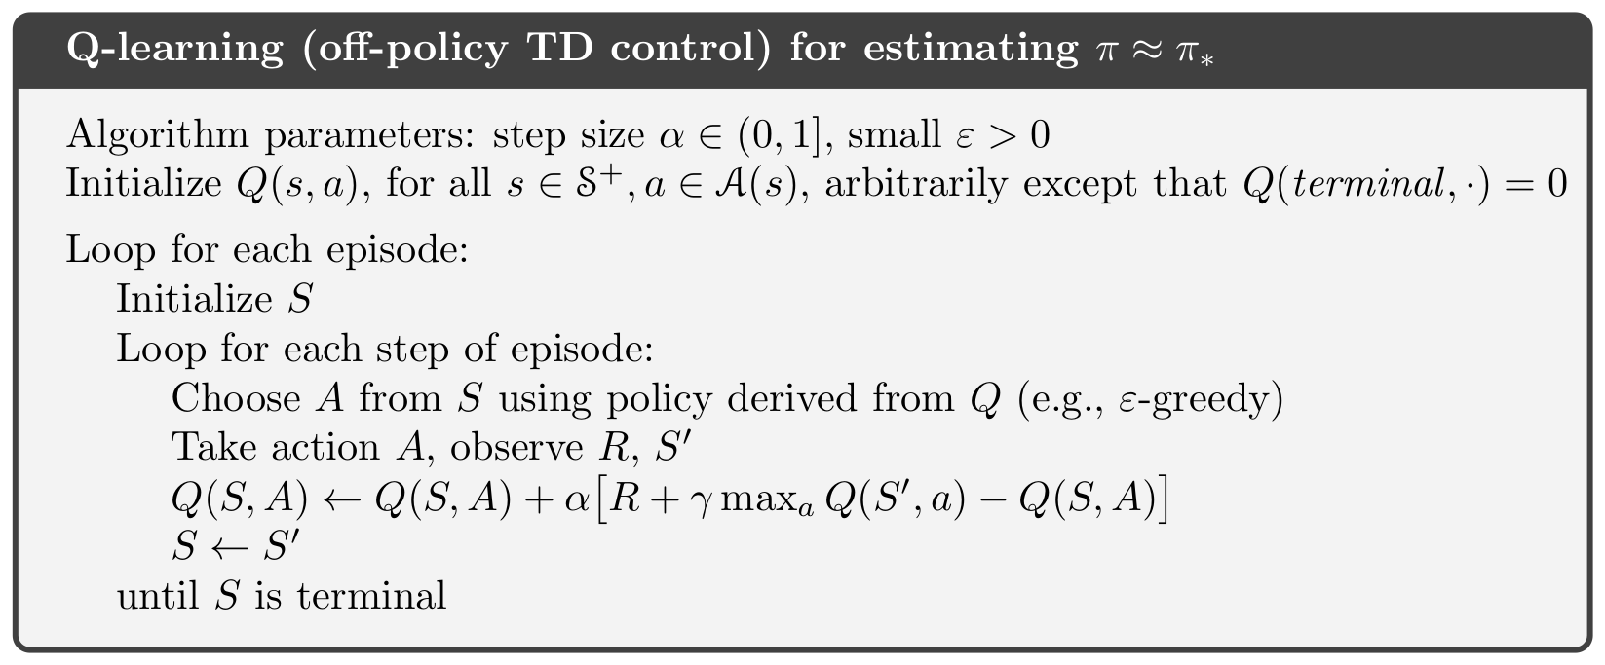
Q- learning Algorithm

Slide 9
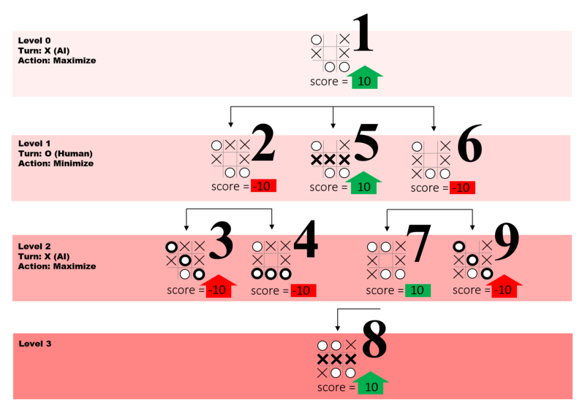
Implementation of MinMax:
Minimizer
The minimizer selects the less values to analyze the best move
Maximizer
The maximizer selects the highest value to caluculate the best move

Slide 10
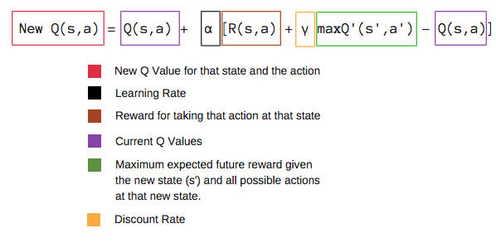
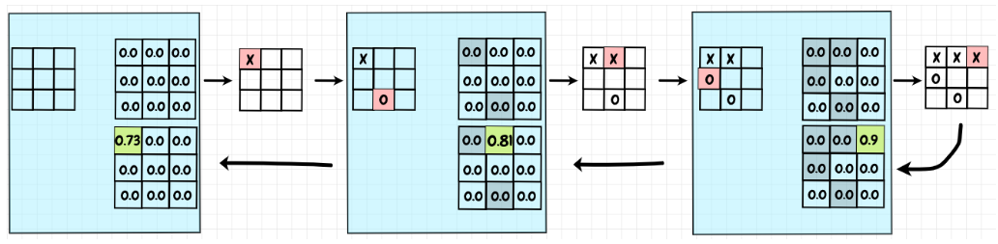
Implementation of Q-learning

Slide 11
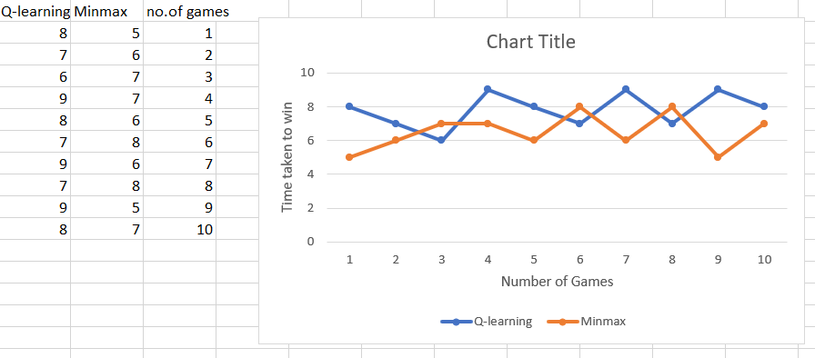
Evaluation and RESULTSult
Out of 10 games Minmax algorithm won 7 times and Q-learning wins only 3 times when we compare both the algorithms.

Slide 12
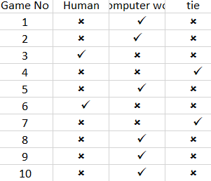
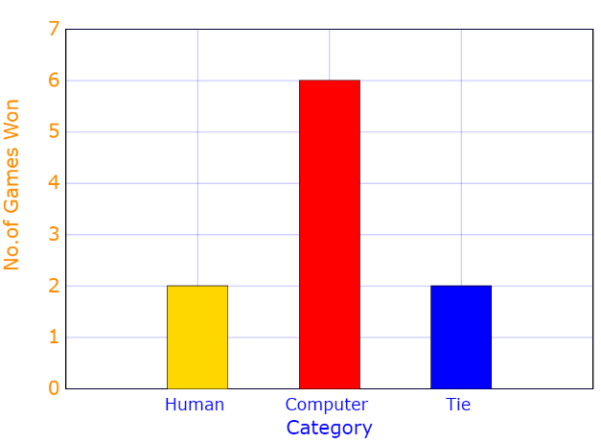
Minmax Winning

Slide 13
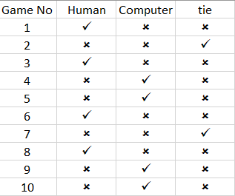
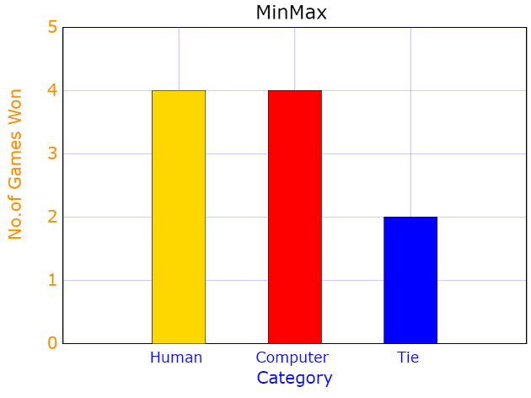
Q- Learning Winning

Slide 14
Conclusion
Complexity
Qlearning algorithm is more complicated than Minmax Algorithm
Time Taken to complete
Minmax completes quickly than Q-learning
Unbeatable game can be made with
Minmmax algorithm is best for making the unbeatable game

Slide 15
Thank You

